Slide 1
CS F415: Data Mining
Yashvardhan Sharma

Slide 2
Today’s Outline
Data Preprocessing
Measure of Similarity and dissimilarity
Transformation

Slide 3
Similarity and Dissimilarity
Similarity
Numerical measure of how alike two data objects are.
Is higher when objects are more alike.
Often falls in the range [0,1]
Dissimilarity
Numerical measure of how different are two data objects
Lower when objects are more alike
Minimum dissimilarity is often 0
Upper limit varies
Proximity refers to a similarity or dissimilarity

Slide 4
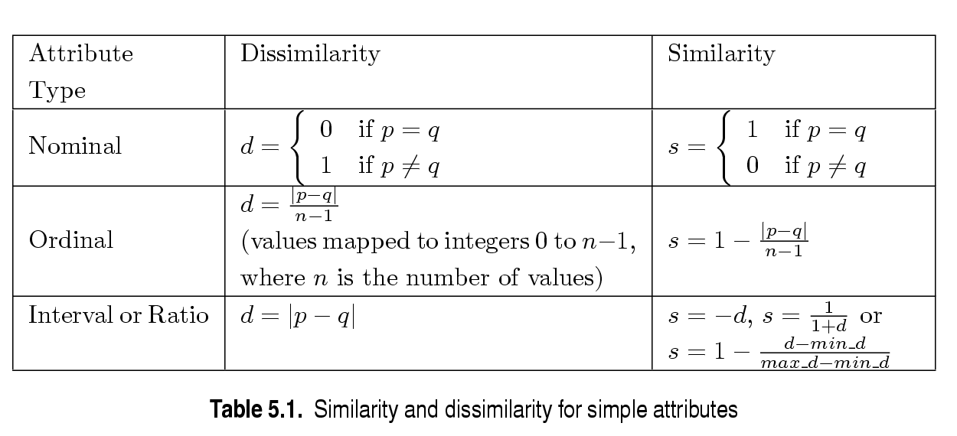
Similarity/Dissimilarity for Simple Attributes
p and q are the attribute values for two data objects.

Slide 5
Euclidean Distance
Euclidean Distance
Where n is the number of dimensions (attributes) and p_{k} and q_{k} are, respectively, the k^{th} attributes (components) of data objects p and q.
Standardization is necessary, if scales differ.

Slide 6
Euclidean Distance
Distance Matrix

Slide 7
Minkowski Distance
Minkowski Distance is a generalization of Euclidean Distance
Where r is a parameter, n is the number of dimensions (attributes) and p_{k} and q_{k} are, respectively, the kth attributes (components) or data objects p and q.

Slide 8
Minkowski Distance: Examples
r = 1. City block (Manhattan, taxicab, L₁ norm) distance.
A common example of this is the Hamming distance, which is just the number of bits that are different between two binary vectors
r = 2. Euclidean distance
r → ∞. “supremum” (L_{max} norm, L∞ norm) distance (also known as Chebyshev distance)..
This is the maximum difference between any component of the vectors
Do not confuse r with n, i.e., all these distances are defined for all numbers of dimensions.

Slide 9
Minkowski Distance
Distance Matrix

Slide 10
Common Properties of a Distance
Distances, such as the Euclidean distance, have some well known properties.
d(p, q) ≥ 0 for all p and q and d(p, q) = 0 only if p = q. (Positive definiteness)
d(p, q) = d(q, p) for all p and q. (Symmetry)
d(p, r) ≤ d(p, q) + d(q, r) for all points p, q, and r. (Triangle Inequality)
where d(p, q) is the distance (dissimilarity) between points (data objects), p and q.
A distance that satisfies these properties is a metric

Slide 11
Common Properties of a Similarity
Similarities, also have some well known properties.
s(p, q) = 1 (or maximum similarity) only if p = q.
s(p, q) = s(q, p) for all p and q. (Symmetry)
where s(p, q) is the similarity between points (data objects), p and q.

Slide 12
Similarity Between Binary Vectors
Common situation is that objects, p and q, have only binary attributes
Compute similarities using the following quantities
M₀₁ = the number of attributes where p was 0 and q was 1
M₁₀ = the number of attributes where p was 1 and q was 0
M₀₀ = the number of attributes where p was 0 and q was 0
M₁₁ = the number of attributes where p was 1 and q was 1
Simple Matching and Jaccard Coefficients
SMC = number of matches / number of attributes
= (M₁₁ + M₀₀) / (M₀₁ + M₁₀ + M₁₁ + M₀₀)
J = number of 11 matches / number of not-both-zero attributes values
= (M₁₁) / (M₀₁ + M₁₀ + M₁₁)

Slide 13
SMC versus Jaccard: Example
p = 1 0 0 0 0 0 0 0 0 0
q = 0 0 0 0 0 0 1 0 0 1
M₀₁ = 2 (the number of attributes where p was 0 and q was 1)
M₁₀ = 1 (the number of attributes where p was 1 and q was 0)
M₀₀ = 7 (the number of attributes where p was 0 and q was 0)
M₁₁ = 0 (the number of attributes where p was 1 and q was 1)
SMC = (M₁₁ + M₀₀)/(M₀₁ + M₁₀ + M₁₁ + M₀₀) = (0+7) / (2+1+0+7) = 0.7
J = (M₁₁) / (M₀₁ + M₁₀ + M₁₁) = 0 / (2 + 1 + 0) = 0

Slide 14
Cosine Similarity
If d₁ and d₂ are two document vectors, then
cos( d₁, d₂ ) = (d₁ • d₂) / ||d₁|| ||d₂|| ,
where • indicates vector dot product and || d || is the length of vector d.
Example:
d₁ = 3 2 0 5 0 0 0 2 0 0
d₂ = 1 0 0 0 0 0 0 1 0 2
d₁ • d₂= 3*1 + 2*0 + 0*0 + 5*0 + 0*0 + 0*0 + 0*0 + 2*1 + 0*0 + 0*2 = 5
||d₁|| = (3*3+2*2+0*0+5*5+0*0+0*0+0*0+2*2+0*0+0*0)^{0.5} = (42) ^{0.5} = 6.481
||d₂|| = (1*1+0*0+0*0+0*0+0*0+0*0+0*0+1*1+0*0+2*2) ^{0.5} = (6) ^{0.5} = 2.245
cos( d₁, d₂ ) = .3150

Slide 15
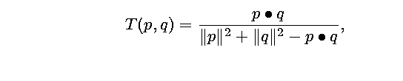
Extended Jaccard Coefficient (Tanimoto)
Variation of Jaccard for continuous or count attributes
Reduces to Jaccard for binary attributes

Slide 16
Correlation Analysis (Nominal Data)
Χ² (chi-square) test
The larger the Χ² value, the more likely the variables are related
The cells that contribute the most to the Χ² value are those whose actual count is very different from the expected count
Correlation does not imply causality
# of hospitals and # of car-theft in a city are correlated
Both are causally linked to the third variable: population

Slide 17
Chi-Square Calculation: An Example
Χ² (chi-square) calculation (numbers in parenthesis are expected counts calculated based on the data distribution in the two categories)
It shows that like_science_fiction and play_chess are correlated in the group
 | Play chess | Not play chess | Sum (row)
Like science fiction | 250(90) | 200(360) | 450
Not like science fiction | 50(210) | 1000(840) | 1050
Sum(col.) | 300 | 1200 | 1500

Slide 18
Correlation Analysis (Numeric Data)
Correlation coefficient (also called Pearson’s product moment coefficient)
where n is the number of tuples, and are the respective means of A and B, σ_{A} and σ_{B} are the respective standard deviation of A and B, and Σ(a_{i}b_{i}) is the sum of the AB cross-product.
If r_{A,B} > 0, A and B are positively correlated (A’s values increase as B’s). The higher, the stronger correlation.
r_{A,B} = 0: independent; r_{AB} < 0: negatively correlated

Slide 19
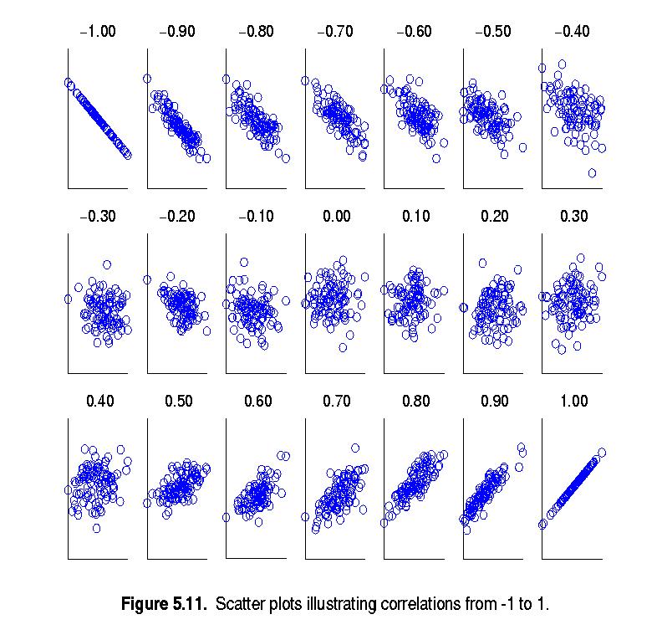
Visually Evaluating Correlation
Scatter plots showing the similarity from –1 to 1.

Slide 20
Correlation
Correlation measures the linear relationship between objects
To compute correlation, we standardize data objects, p and q, and then take their dot product

Slide 21
Correlation analysis
Can detect redundancies

Slide 22
Cont’d
> 0 , A and B positively correlated
values of A increase as values of B increase
The higher the value, the more each attribute implies the other
High value indicate that A (or B) may be removed as a redundancy
= 0, A and B independent (no correlation)
< 0, A and B negatively correlated
Values of one attribute increase as the values of the other attribute decrease (discourages each other)

Slide 23
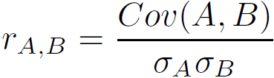
Covariance (Numeric Data)
Covariance is similar to correlation
where n is the number of tuples, and are the respective mean or expected values of A and B, σ_{A} and σ_{B} are the respective standard deviation of A and B.
Positive covariance: If Cov_{A,B} > 0, then A and B both tend to be larger than their expected values.
Negative covariance: If Cov_{A,B} < 0 then if A is larger than its expected value, B is likely to be smaller than its expected value.
Independence: Cov_{A,B} = 0 but the converse is not true:
Some pairs of random variables may have a covariance of 0 but are not independent. Only under some additional assumptions (e.g., the data follow multivariate normal distributions) does a covariance of 0 imply independence
Correlation coefficient:

Slide 24

Co-Variance: An Example
It can be simplified in computation as
Suppose two stocks A and B have the following values in one week: (2, 5), (3, 8), (5, 10), (4, 11), (6, 14).
Question: If the stocks are affected by the same industry trends, will their prices rise or fall together?
E(A) = (2 + 3 + 5 + 4 + 6)/ 5 = 20/5 = 4
E(B) = (5 + 8 + 10 + 11 + 14) /5 = 48/5 = 9.6
Cov(A,B) = (2×5+3×8+5×10+4×11+6×14)/5 − 4 × 9.6 = 4
Thus, A and B rise together since Cov(A, B) > 0.

Slide 25
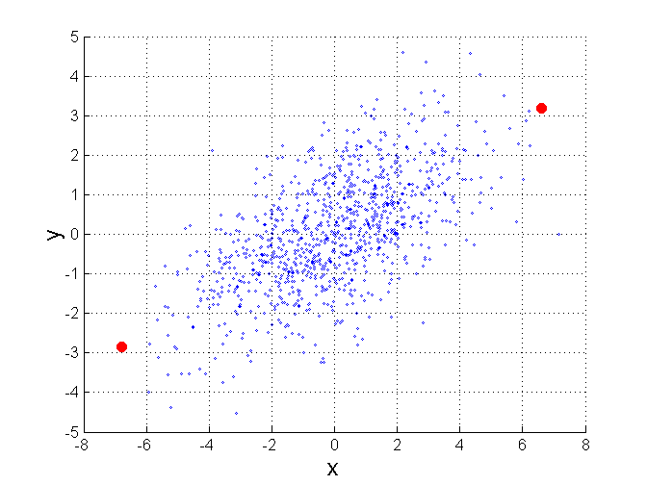
Mahalanobis Distance
Σ is the covariance matrix of the input data X
For red points, the Euclidean distance is 14.7, Mahalanobis distance is 6.

Slide 26
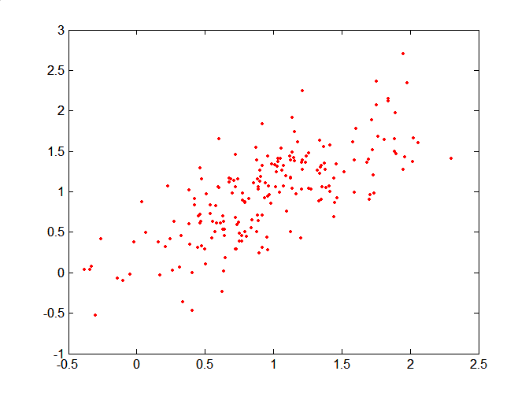
Mahalanobis Distance
Covariance Matrix:
C
B
A: (0.5, 0.5)
B: (0, 1)
C: (1.5, 1.5)
Mahal(A,B) = 5
Mahal(A,C) = 4
A

Slide 27
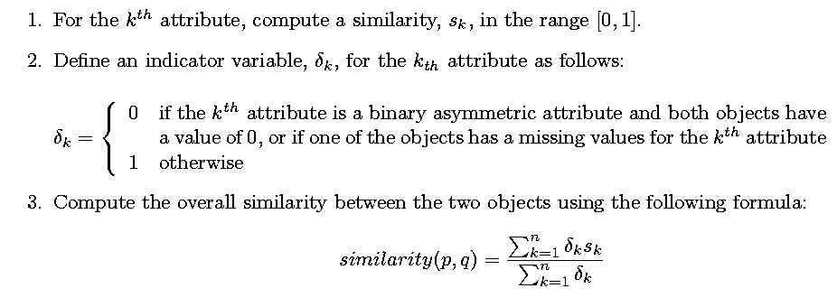
General Approach for Combining Similarities
Sometimes attributes are of many different types, but an overall similarity is needed.

